Slide 1
Employee Data Analysis using Excel
STUDENT NAME: JANANI N D
REGISTER NO: 312219356
NM ID: C64795E0A6F40989F8F40D3AE82F6CF7
UNM: unm1711312219356
DEPARTMENT: B.COM Accounting & Finance
COLLEGE: SA COLLEGE OF ARTS AND SCIENCE

Slide 2
PROJECT TITLE
Employee Performance Analysis using Excel

Slide 3


AGENDA
Problem Statement
Project Overview
End Users
Our Solution and Proposition
Dataset Description
Modelling Approach
Results and Discussion
Conclusion
3/21/2024 Annual Review

Slide 4

PROBLEM STATEMENT
"To enhance organizational productivity and identify key factors contributing to employee performance, our company seeks to implement a robust performance analysis system using Excel. The current challenge lies in the lack of a centralized, data-driven approach to evaluate employee productivity, efficiency, and overall contribution to the company. By analyzing various performance metrics such as attendance, task completion rates, project success, and peer feedback, we aim to gain actionable insights that will help in making informed decisions on training needs, rewards, and career development. The goal is to create a comprehensive Excel-based performance dashboard that not only tracks individual and team performance but also identifies trends and patterns over time, enabling management to foster a more efficient and motivated workforce."

Slide 5

PROJECT OVERVIEW
Objective: The project aims to develop a comprehensive and user-friendly Excel-based tool to analyze and visualize employee performance across various key performance indicators (KPIs). The tool will enable management to track, assess, and improve employee productivity, engagement, and overall contribution to the organization's goals.
Scope: The project will involve collecting and organizing employee performance data, including metrics such as attendance, task completion rates, project outcomes, peer feedback, and professional development activities. The data will be analyzed to identify performance trends, strengths, and areas for improvement. The final deliverable will be an interactive Excel dashboard that provides a clear, real-time view of individual performance.

Slide 6
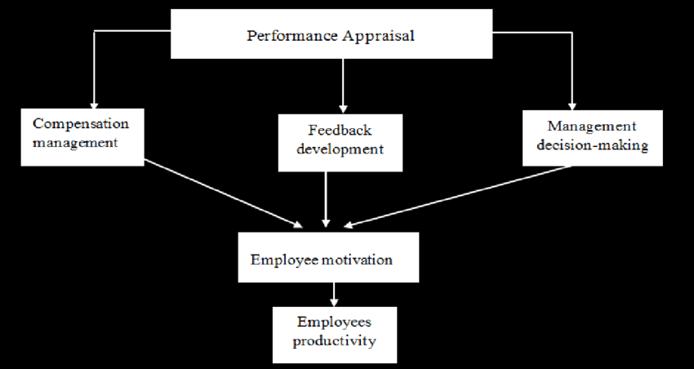

Slide 7


WHO ARE THE END USERS?
Human Resources (HR) Team:
Managers and Team Leaders:
Executives and Senior Management:
Performance Review Committees:
Employees :
Learning and Development Teams:

Slide 8

OUR SOLUTION AND ITS VALUE PROPOSITION
Data-Driven Insights:
The solution empowers organizations to make informed decisions by providing clear, data-backed insights into employee performance. This reduces the reliance on subjective evaluations and helps ensure fairness and accuracy in performance reviews.
Improved Efficiency:
By automating the collection, organization, and analysis of performance data, the tool saves time and effort for HR professionals and managers. It eliminates the need for manual tracking and reporting, allowing teams to focus on more strategic tasks.

Slide 9
Enhanced Performance Management:
The tool helps identify performance trends, enabling proactive management of employee development. Managers can quickly pinpoint areas of improvement, recognize top performers, and provide targeted support where needed, leading to a more engaged and productive workforce.
Cost-Effective Solution:
Leveraging Excel, a tool already widely used in most organizations, the solution avoids the need for expensive, specialized software. It offers a powerful yet accessible way to manage employee performance without additional costs.
Customizable and Scalable:
The tool can be easily customized to align with the specific needs and goals of the organization. As the organization grows, the solution can scale to accommodate more employees and additional performance metrics, ensuring long-term usability.

Slide 10
Dataset Description
The dataset is designed to provide a comprehensive view of each employee's contributions, efficiency, and engagement within the organization.
Employee ID: A unique identifier for each employee.
Name: The full name of the employee.
Department: The department or team the employee belongs to (e.g., Sales, Marketing, IT).
Position/Role: The employee's job title or role within the organization.
Gender: The gender of the employee.
Overall Performance Rating: A summary rating from the performance review (e.g., Exceeds Expectations, Meets Expectations, Below Expectations).

Slide 11

THE "WOW" IN OUR SOLUTION
Real-Time Data Integration:
Wow Factor: The solution integrates real-time data from various sources, allowing for up-to-the-minute performance tracking and analysis. This feature ensures that managers and HR teams always have the most current information at their fingertips.
Predictive Analytics:
Wow Factor: By incorporating predictive analytics, the tool can forecast future performance trends, identify potential issues before they arise, and suggest proactive measures. For example, it could predict which employees are at risk of burnout based on their workload and engagement levels.
11

Slide 12
Personalized Performance Insights:
Wow Factor: The solution offers personalized insights for each employee, highlighting their unique strengths and areas for improvement. This customization makes feedback more relevant and actionable, enhancing employee engagement and growth.
Dynamic Scenario Analysis:
Wow Factor: Managers can use the tool to perform “what-if” analyses, exploring different scenarios (e.g., how performance might improve if certain training is provided) to make data-driven decisions. This feature helps in planning and resource allocation
Visual Storytelling:
Wow Factor: The dashboard isn't just a collection of charts—it tells a story. With intuitive visualizations, the data is presented in a narrative format that highlights key insights and trends in a compelling way. This makes it easier for stakeholders to understand and act on the data.

Slide 13
MODELLING
Data Filtering:
Purpose: Allows you to focus on specific subsets of data, such as a particular department, date range, or performance rating.
Implementation:
Auto Filter: Apply Excel’s Auto Filter feature to your data columns. This allows you to quickly filter by criteria such as department, employee role, or performance rating.
Advanced Filters: Use Excel’s Advanced Filters to create more complex criteria, such as filtering employees with a performance rating above a certain threshold or those who have completed specific training programs.
Example:
Filter the data to show only employees from the "Sales" department with an "Exceeds Expectations" rating in the last quarter.
13

Slide 14
Pivot Tables:
Purpose: Summarize, analyze, and explore large datasets by aggregating data across multiple dimensions (e.g., department, performance rating, attendance).
Implementation:
Creating a Pivot Table: Select your data range and insert a Pivot Table. Choose fields such as "Department" for rows, "Performance Rating" for columns, and "Employee Count" or "Average Task Completion Rate" for values.
Grouping: Group data by categories, such as grouping performance ratings or aggregating data by month or quarter.
Calculated Fields: Add calculated fields within the pivot table to create new metrics, such as "Average Performance Score" or "Total Projects Completed."
Example:
Create a pivot table that shows the average performance rating by department and job role, with a breakdown by gender or tenure.

Slide 15
Charts:
Purpose: Visualize the summarized data from pivot tables or filtered datasets to identify trends, patterns, and outliers.
Implementation:
Bar and Column Charts: Ideal for comparing performance metrics across different departments or employee groups.
Line Charts: Useful for showing performance trends over time, such as monthly or quarterly performance ratings.
Pie Charts: Can be used to display the distribution of performance ratings or the proportion of employees in different performance categories.
Combo Charts: Combine different types of charts (e.g., bar and line) to visualize relationships between different performance metrics, such as task completion rates and error rates.
Example:
Create a line chart showing the trend of average employee engagement scores over the last year, alongside a bar chart of employee participation in company activities.

Slide 16
Modeling Workflow Example:
Start with Data Filtering:
Filter the dataset to focus on the latest quarter's performance data for the "Marketing" and "Sales" departments.
Summarize with Pivot Tables:
Create a pivot table to summarize average performance scores by department and job role. Add a calculated field to show the percentage of tasks completed on time.
Visualize with Charts:
Use a column chart to compare average performance ratings across departments and a line chart to track the performance trend over the past year.
Highlight Insights with Conditional Formatting:
Apply color scales to the performance ratings in the pivot table, using green for high performers and red for those needing improvement. Add data bars to the task completion percentages to quickly see who’s on track.
This combination of filtering, pivot tables, charts, and conditional formatting will provide a powerful, interactive way to analyze employee performance data, enabling you to draw meaningful insights and make informed decisions.

Slide 17
RESULTS
17

Slide 18
conclusion
The Employee Performance Analysis project using Excel provides a comprehensive and efficient solution for monitoring, evaluating, and enhancing employee performance across the organization. By leveraging Excel's powerful data analysis tools—such as filtering, pivot tables, charts, and conditional formatting—the project offers a centralized platform for real-time performance tracking and insightful decision-making.
This project delivers several key benefits, including the ability to identify top performers, pinpoint areas for improvement, and make data-driven decisions regarding training, development, and recognition programs. The use of predictive analytics, personalized insights, and intuitive visualizations further enhances the tool's value, making it an indispensable resource for HR teams, managers, and executives.
Through this solution, the organization can foster a culture of continuous improvement, where employees are empowered with clear feedback and targeted development opportunities. This not only drives individual performance but also aligns workforce efforts with the company’s strategic goals, ultimately leading to higher productivity, better employee engagement, and sustained organizational success.
By offering a scalable, customizable, and cost-effective solution, this project positions the organization to adapt and thrive in a dynamic business environment, ensuring that both current and future performance management needs are met with precision and effectiveness.

